Slide 1



Waste Classification Using CNN
Name – Kush Lodhi
3rd Year CSE
Lakshmi Narain College of Technology (LNCT), Bhopal

Slide 2
Problem Statement:
Develop the CNN (Convolutional Neural Network) Model that can automatically predict waste type as Organic or Recyclable using image recognition techniques using the given dataset for Training and Testing which contain images of organic waste (food scraps, leaves) and recyclable waste (plastic, glass, paper, metal)
Dataset Link - https://www.kaggle.com/datasets/techsash/waste-classification-data
Challenges:
Inefficient manual waste sorting
Misclassification reduces recycling efficiency
Need for an automated AI-based waste classification system

Slide 3

Learning Objectives
Understand Waste Classification – Learn how AI models can be used to classify waste into Organic and Recyclable categories for better waste management.
Develop a CNN-Based Model – Build a Convolutional Neural Network (CNN) that can automatically recognize and categorize waste items from images.
Enhance Accuracy Through Preprocessing – Improve model performance using data preprocessing, augmentation, and optimization techniques.
Promote Efficient Recycling – Implementing AI-powered waste detection system that can help reduce human effort, improve recycling efficiency, and minimize environmental impact.
GOAL

Slide 4



Tools and Technology used
Programming Language used
Python – Python is used as primary language for model training, data processing, and data visualization.
Libraries used
OpenCV – Used for image processing.
Tensorflow & Keras – Used for building and training the CNN model.
NumPy & Pandas – For numerical computations and dataset handling.
Matplotlib – Used for data visualization.
tqdm – To show progress bars for loop processes.

Slide 5

CNN Model Architecture
A Convolutional Neural Network (CNN) is a deep learning algorithm that can automatically learn patterns and features from images. It is mainly used for image classification, object detection, and computer vision tasks.
Model Layers:
Conv2D(32) + ReLU + MaxPooling2D
Conv2D(64) + ReLU + MaxPooling2D
Conv2D(128) + ReLU + MaxPooling2D
Flatten() + Dense(256) + Dropout(0.5)
Dense(64) + Dropout(0.5) + Output Layer (Softmax)
Platform used
VS Code: Lightweight, extensible code editor for multiple programming languages.
Jupyter Notebook: Interactive web-based environment for coding, visualization, and data analysis.

Slide 6
Methodology
Setting up environment & Importing other necessary libraries
Installing required libraries OpenCV for image processing and Tensorflow is used to build and train the CNN model.
For performing task on the data like numerical computations, dataset structure, visualize data, image processing and hide unnecessary warnings for clear output.
Libraries – numpy, pandas, matplotlib, cv2, tqdm, warnings.
Data Collection
The dataset consists of images categorized into Organic Waste and Recyclable Waste. The images are divided into Train and Test folders to ensure proper training and evaluation of the CNN model.
Tools & Functions – os, glob(), cv2.imread()
Data Preprocessing
Before training, all images are resized, normalized, and augmented to improve model performance and prevent overfitting.
Tools & Functions – cv2.resize(), ImageDataGenerator()

Slide 7
4. CNN Model Development
A Convolutional Neural Network (CNN) is designed with multiple layers to extract meaningful features from waste images and classify them into Organic or Recyclable Waste.
Tools & Functions – Sequential(), Conv2D(), MaxPooling2D()
Model Training
The CNN model is compiled and trained using the Adam optimizer and Binary Crossentropy loss function. Training is done on augmented images for 8 epochs.
Tools & Functions – model.compile(), model.fit()
Model Evaluation
The trained model is evaluated using accuracy and loss metrics. Training and validation curves are plotted to assess model performance.
Tools & Functions – plt.plot(), hist.history[]
7. Model Testing
The trained model is used to classify new images of waste. The image is preprocessed, fed into the model, and the predicted class (Organic/Recyclable) is displayed.
Tools & Functions – model.predict(), np.reshape()

Slide 8
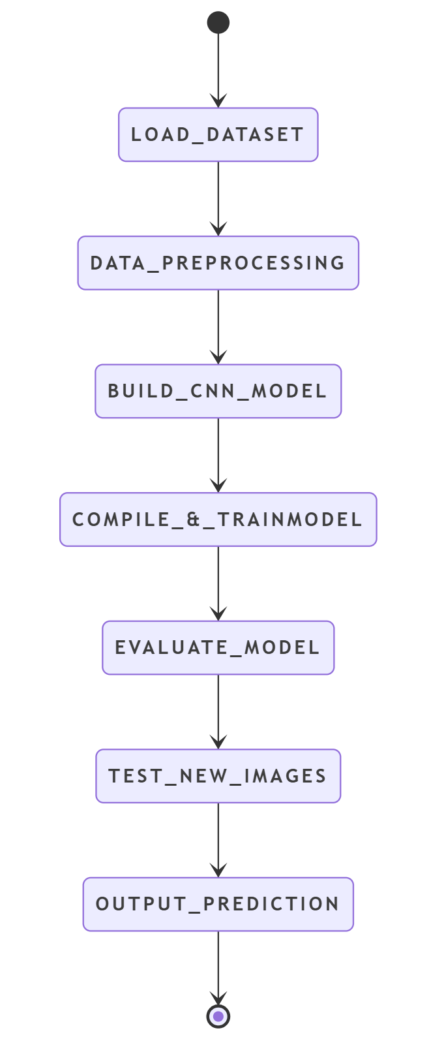
Final Flow Chart of Project
Explanation of Flowchart Steps
Load Dataset – Load training and testing images of Organic & Recyclable waste.
Data Preprocessing – Resize images, normalize pixel values, and apply data augmentation.
Build CNN Model – Define layers including Conv2D, MaxPooling, Flatten, and Dense.
Compile & Train Model – Use Adam optimizer and train for 8 epochs.
Evaluate Model – Check training and validation accuracy/loss using graphs.
Test with New Images – Preprocess input images and feed them into the model.
Output Prediction – Predict if the waste is Organic or Recyclable.

Slide 9
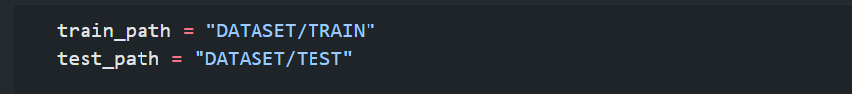
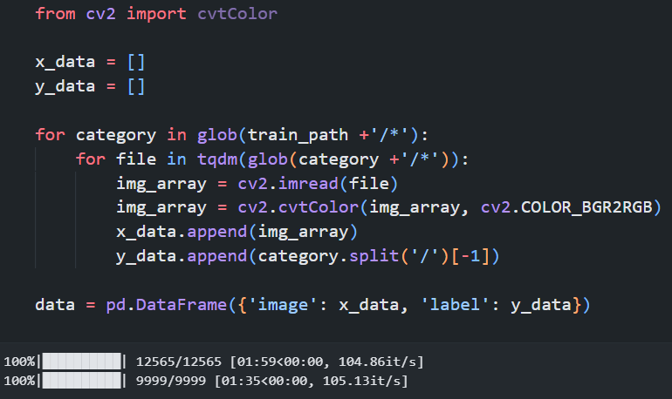
Solution:
Providing data path from dataset
The dataset consists of two main folders (TRAIN & TEST), each containing two subfolders for Organic and Recyclable Waste.
Fetch data from dataset
Once we have the file paths, we can read and process images using OpenCV(cv2)

Slide 10
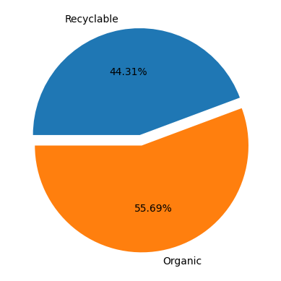
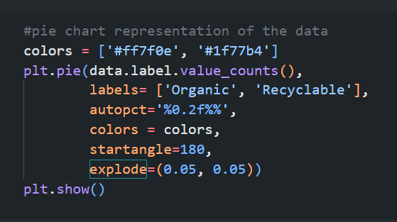
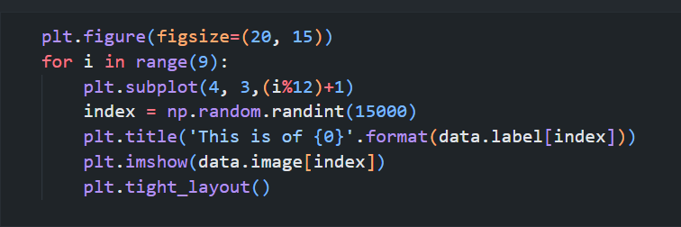
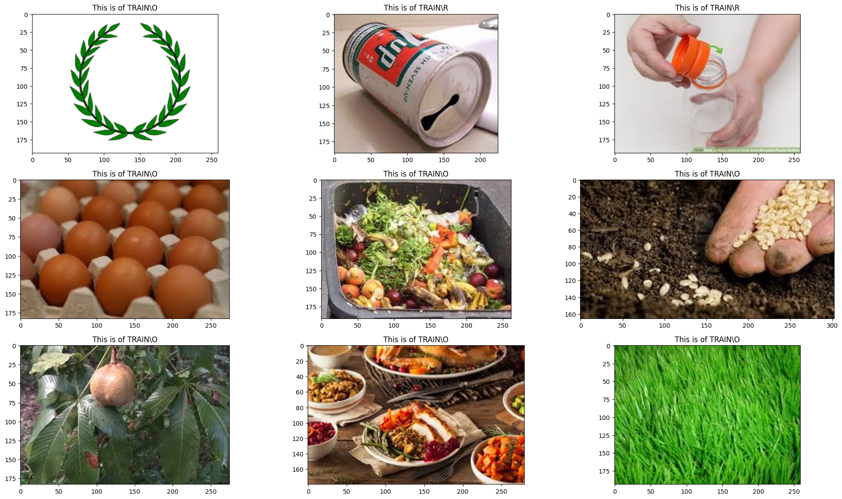
Visual representation of the in pie chart
A pie chart is used to visualize the percentage of Organic and Recyclable waste images in the dataset.
Before training, random images are displayed to get an idea of the dataset quality and variety.

Slide 11
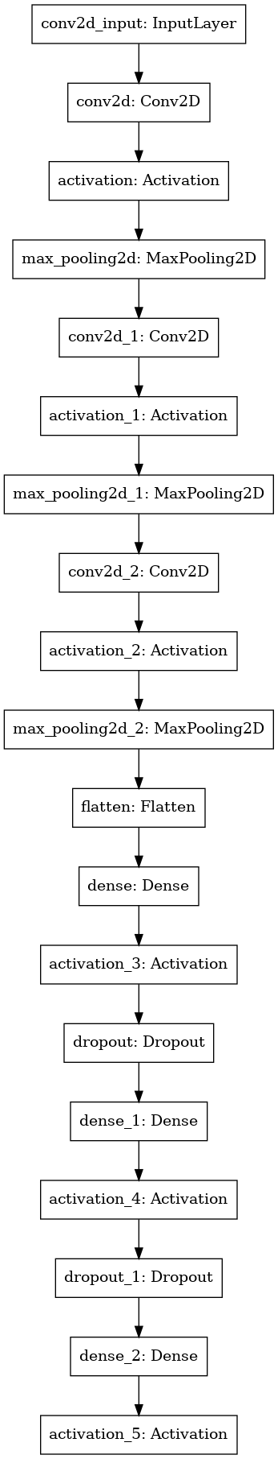
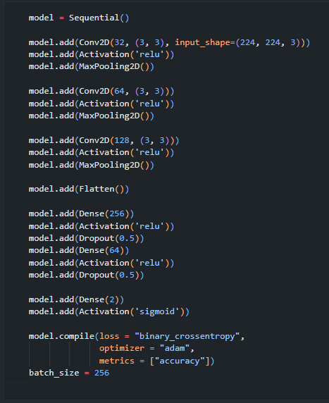
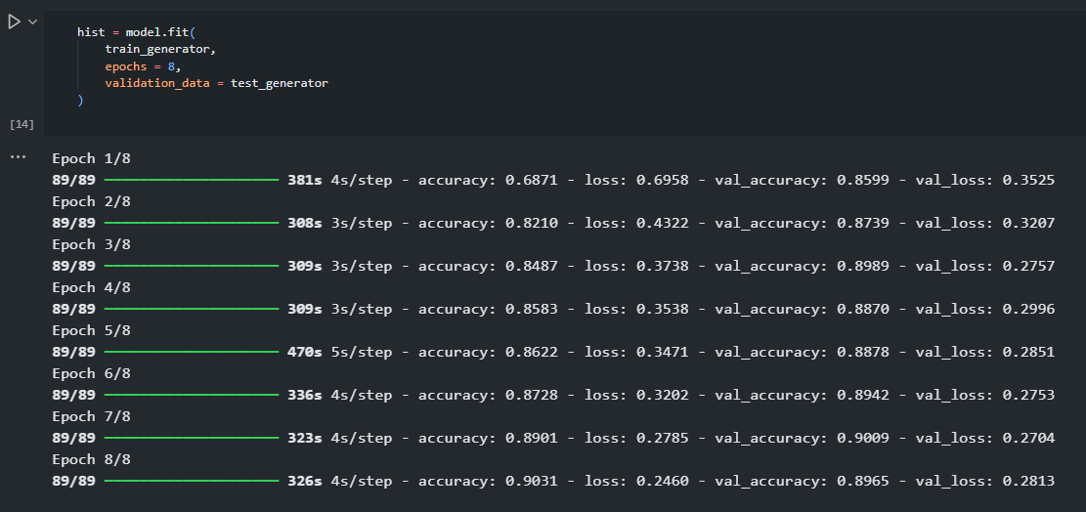
Defining Architecture CNN model
The CNN model consists of three convolutional layers, followed by fully connected layers for classification.
Training the model
Once the model is compiled, it is trained on the training dataset and validated using the test dataset.

Slide 12
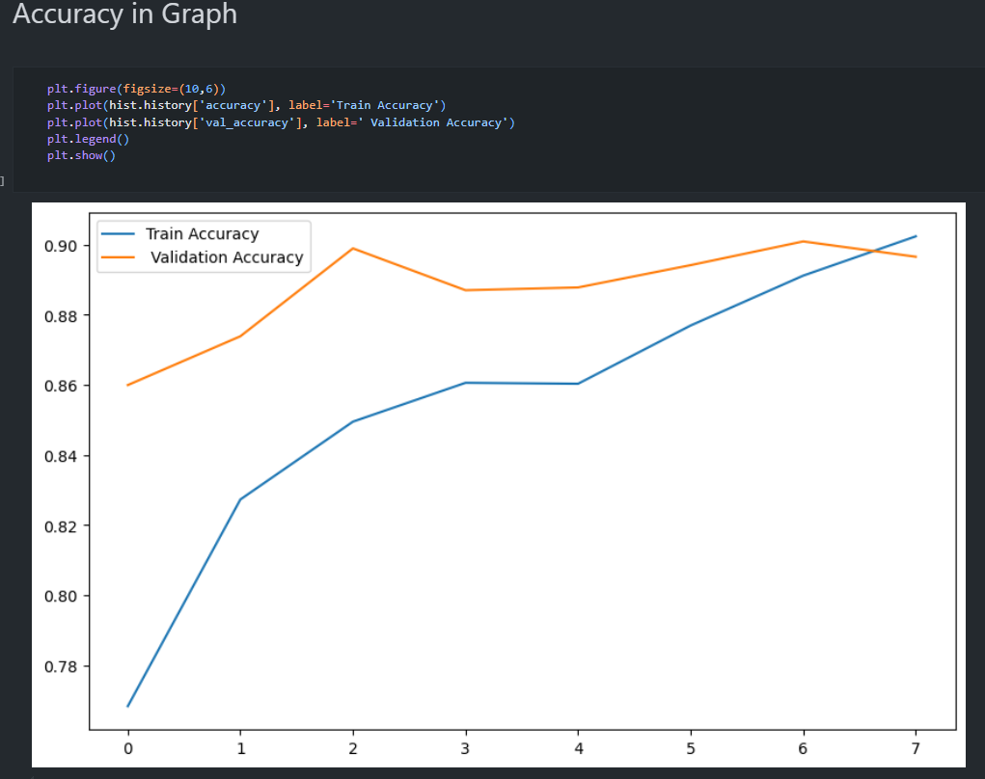
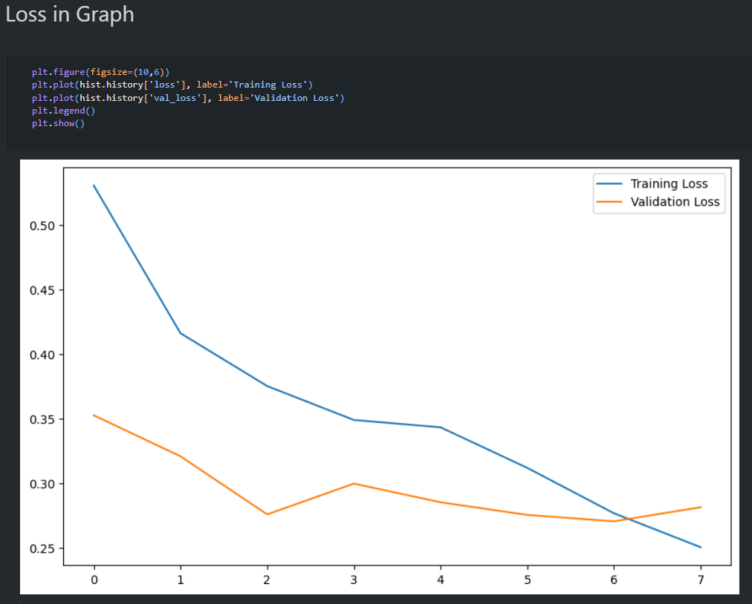
Evaluating Model Performance
After training, the model's performance is evaluated using accuracy and loss graphs.

Slide 13
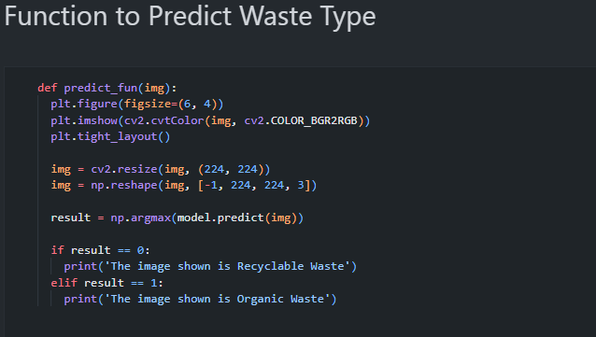
Prediction Function
The predict_fun() function takes an image as input, preprocesses it, and predicts whether the waste is Organic or Recyclable using the trained CNN model.

Slide 14
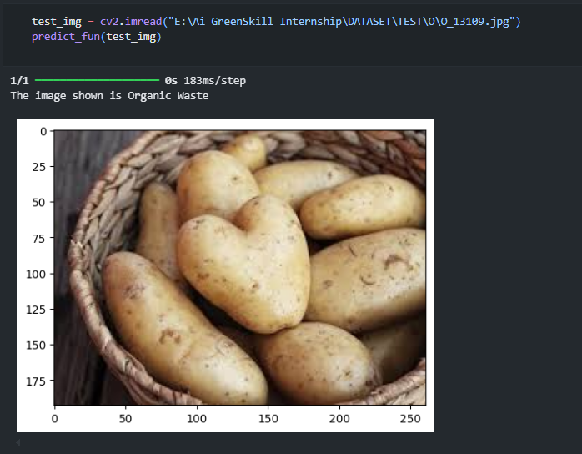
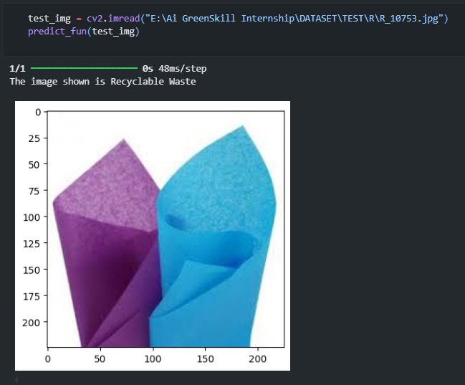
Screenshot of Output:

Slide 15
Conclusion:
In this project, a Convolutional Neural Network (CNN) was successfully developed to classify waste images as Organic or Recyclable. The model was trained using a dataset containing labeled waste images, with data preprocessing, augmentation, and deep learning techniques applied to improve accuracy.
Key Achievements:
Successfully implemented a CNN model for waste classification.
Applied image preprocessing (resizing, normalization, augmentation) for better learning.
Achieved high accuracy (~90%) on the test dataset.
Developed a prediction function to classify new waste images.
Important Links
Dataset Link – Click here
Repo Link – Click Here

